Slide 1
Spur Gear Design
Contact Stress in Gear Teeth

Slide 2
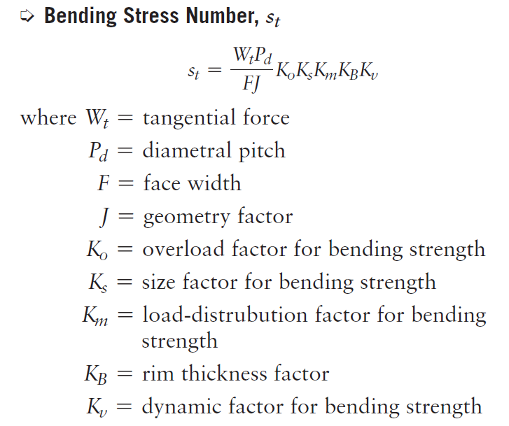
Bending Stress Number (s_{t})

Slide 3

Contact Stress in Gear Teeth
Pitting is the phenomenon in which small particles are removed from the surface of the tooth faces because of the high contact stresses, causing fatigue.
Prolonged operation after pitting begins causes the teeth to roughen, and eventually the form is deteriorated. Rapid failure follows.
Note that both the driving and driven teeth are subjected to these high contact stresses equally.

Slide 4
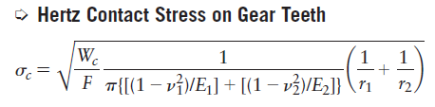
Contact Stress in Gear Teeth
Because of the elasticity of the materials, the tooth shape deforms slightly, resulting in the transmitted force acting on a small rectangular area.
The resulting stress is called a contact stress or Hertz stress.

Slide 5
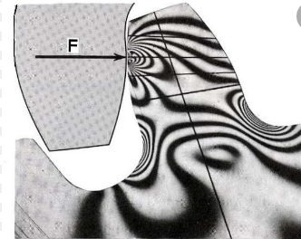
Contact Stress in Gear Teeth

Slide 6
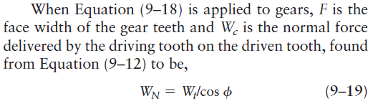
Contact Stress in Gear Teeth
The tensile modulus of elasticity is E and the Poisson’s ratio is v. W_{c} is the contact force exerted between the two bodies, and F is the length of the contacting surfaces. The radii of curvature of the two surfaces are called r₁ and r₂.

Slide 7
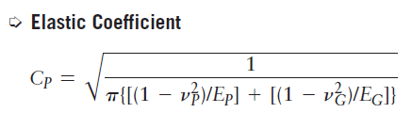
Contact Stress in Gear Teeth
The second term in Equation (9–18) (including the square root) can be computed if the elastic properties of the materials for the pinion and gear are known. It is given the name elastic coefficient, C_{P}.

Slide 8
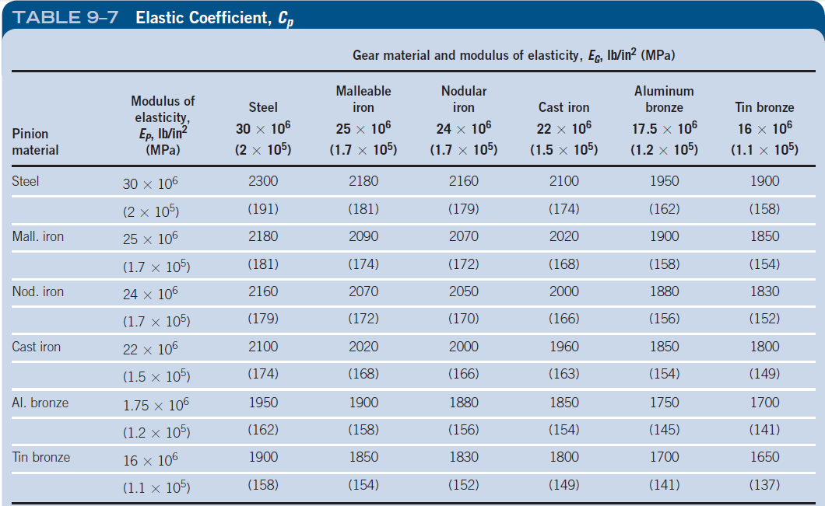
Elastic Coefficient C_{P}
Manufacturers, designers, and users of gears must agree on standards used to determine the acceptability of gears produced.
The current AGMA standard 2015-1-A01 employs 10 accuracy grades from A2 (most precise) to A11 (least precise).

Slide 9
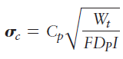
Contact Stress in Gear Teeth
Considering all the parameters, the contact stress equation becomes:
Where I is the geometry factor, C_{P} is the elastic coefficient, D_{P} is the pinion pitch diameter, and F is the face width of the gears.

Slide 10
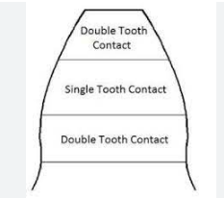
Contact Stress in Gear Teeth
The radii of curvatures are the radius of two teeth at the contact point. It changes throughout the meshing cycle as the contact point moves from top of teeth through the pitch circle to the lower flank of teeth before leaving engagement.
AGMA calls for the computation of contact stress to be made at the lower point of single tooth contact (LPSTC) because above that point load will be shared with other teeth

Slide 11
Contact Ratio
In gear meshing, the lower the value of the contact ratio, the more load one tooth is subjected to and the greater the deflection and noise of the tooth tends to be.
Gears rotate by repeating "one-tooth meshing" and "two-tooth meshing".
The ratio of the frequency of one-tooth meshing to two-tooth meshing is expressed by the contact ratio
The higher the proportion of two-tooth meshing in the total, the higher the contact ratio value. In the case of one-tooth meshing, the entire load is applied to a single tooth, so the tooth
more likely to break or suffer surface pressure damage. In the case of two-tooth meshing, the load is shared between the two teeth, so cases with a
high two-tooth meshing ratio are superior in terms of strength.
For gears to rotate accurately, the contact ratio must be greater than 1.
For example, if the contact ratio is 1.4, each 0.4 at the beginning and end of the meshing is two-tooth meshing and 0.6 in between is one-tooth meshing.
When gear teeth are shifted, positive shifting results in a larger operating pressure angle and a lower contact ratio. If negative shifting is applied, the operating pressure angle becomes smaller and the contact ratio becomes higher (when there is no undercut). In helical gears, the teeth are helical, which increases the contact ratio and thus reduces the deflection of the teeth, which in turn reduces noise and vibration.

Slide 12
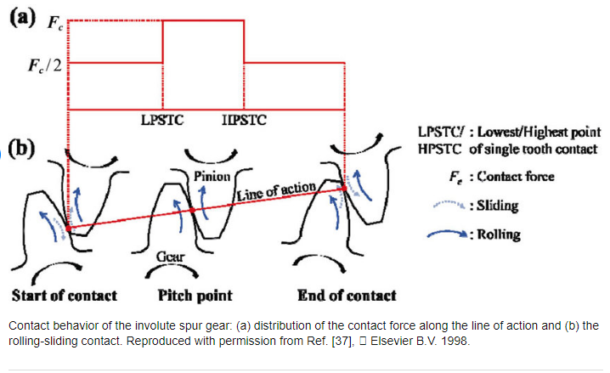
Contact Stress in Gear Teeth

Slide 13
References
J. of the Braz. Soc. of Mech. Sci. & Eng (April-June 2012, Vol. XXXIV). The Influence of Contact Stress Distribution and Specific Film Thickness on the Wear of Spur Gears During Pitting Tests. Retrieved from
https://www.scielo.br/j/jbsmse/a/KLbfYKKpHJntHTjP7HmbmJR/?format=pdf&lang=en

Slide 14
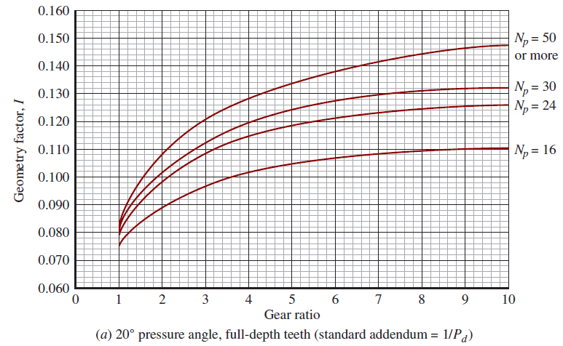
Geometry Factor I

Slide 15
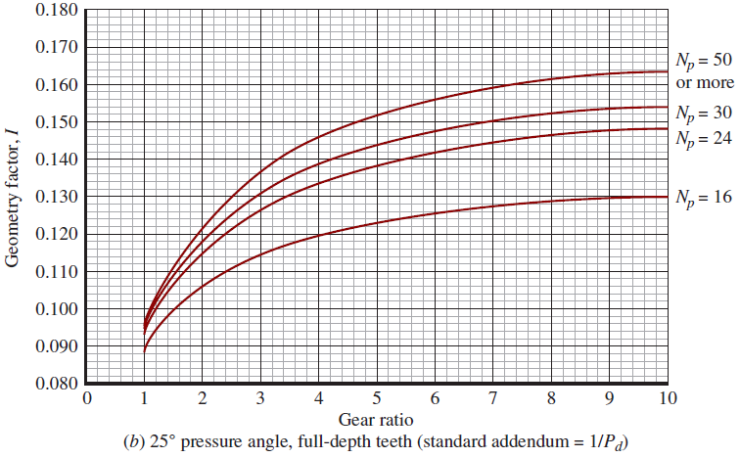
Geometry Factor I

Slide 16
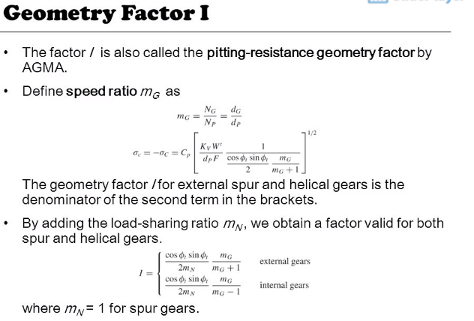

Slide 17
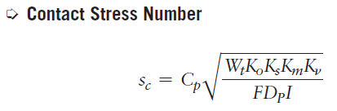
contact stress number, s_{c}
As with the equation for bending stress in gear teeth, several factors are added to the equation for contact stress.

Slide 18
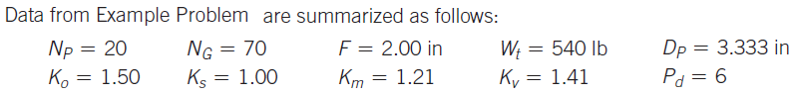
Example Problem
Compute the contact stress number for the gear pair described in the previous example for bending stress.

Slide 19
Metallic Gear Materials
From a mechanical design standpoint, strength and pitting resistance are the most important properties.
In general, the designer should consider the producibility of the gear, considering the manufacturing processes involved, from the preparation of the gear blank, through the forming of the gear teeth, to the final assembly of the gear into a machine.

Slide 20
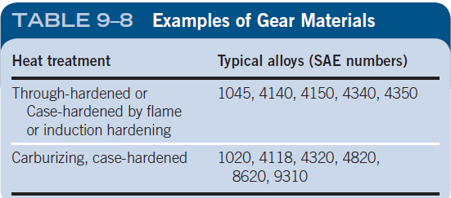
Carbon and Alloy Steel
Many carbon and alloy steels are used for gears and most are given heat treatments to provide controlled hardness and strength.
Selection of the alloy depends, in part, on the heat-treatment process used to achieve the final properties.

Slide 21
Steel Gear Materials
Through-Hardened Steels. Gears for machine tool drives and many kinds of medium- to heavy-duty speed reducers and transmissions are typically made from medium-carbon steels.

Slide 22
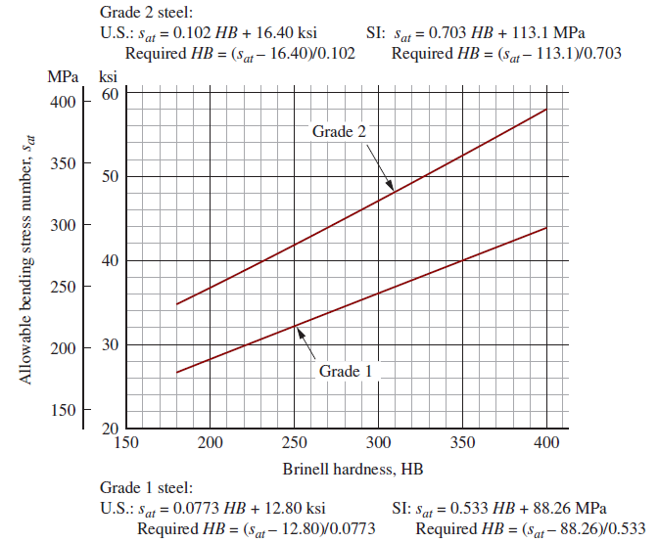
Bending Stress Numbers and Brinell Hardness

Slide 23
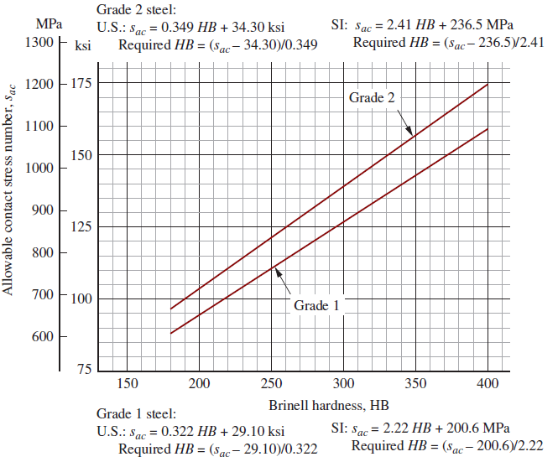
Contact Stress Numbers and Brinell Hardness

Slide 24
Grade of Steels Through Hardened Gears
Grade 1 is considered to be the basic standard.
Grade 2 requires a higher degree of control of the microstructure, alloy composition, greater cleanliness, prior heat treatment, nondestructive testing performed, core hardness values, and other factors.
Because of these extra requirements, cost is likely to be higher.

Slide 25
Case-Hardened Steels
Flame hardening, induction hardening, carburizing, and nitriding are processes used to produce a high hardness in the surface layer of gear teeth.
Case-hardened steel gears can be produced to Grades 1, 2, and 3 with Grade 1 referring to typically available steels as discussed for through-hardened steels. Because of the special care required in producing Grades 2 and 3.

Slide 26
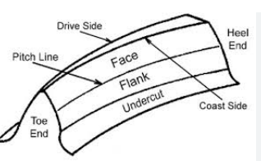
Referring Chapter:2 (Page:49)……..
The most critical area for hardening of gear teeth is typically the flanks where the two meshing teeth make contact and transmit the driving forces.
High contact stresses where the two curved surfaces meet must be resisted. Pitting resistance of the teeth is directly related to the hardness of the flanks and that is the most prominent failure mode for gears that are to be used for many thousands of hours of expected life.

Slide 27
The area where the root of the tooth blends with the involute tooth form of the flank experiences the highest bending stress.
For gears that are used intermittently, bending fatigue is often the predominant mode of failure. Ensuring that the fillet area is adequately hardened will optimize the fatigue life.

Slide 28
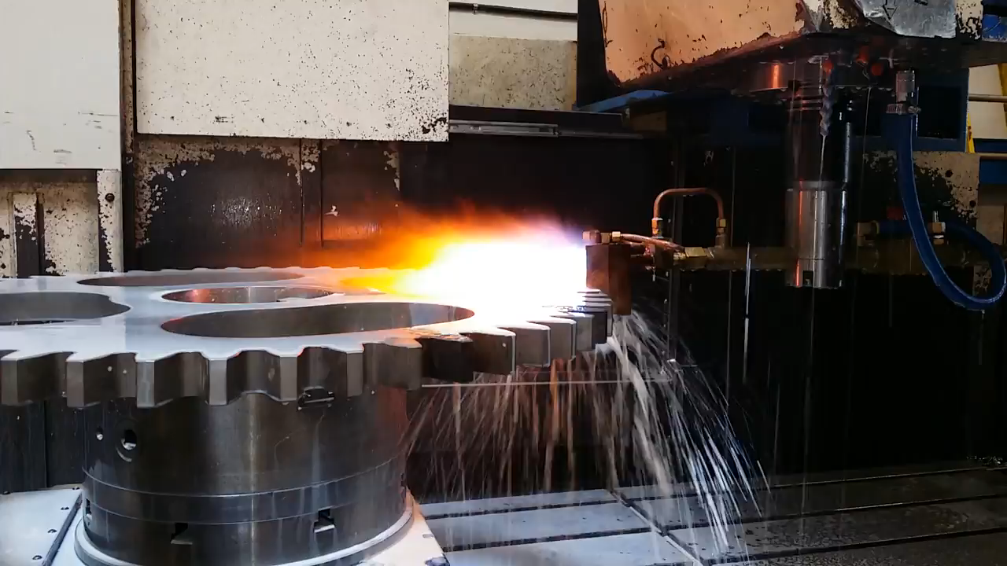
Case-Hardened Steels

Slide 29
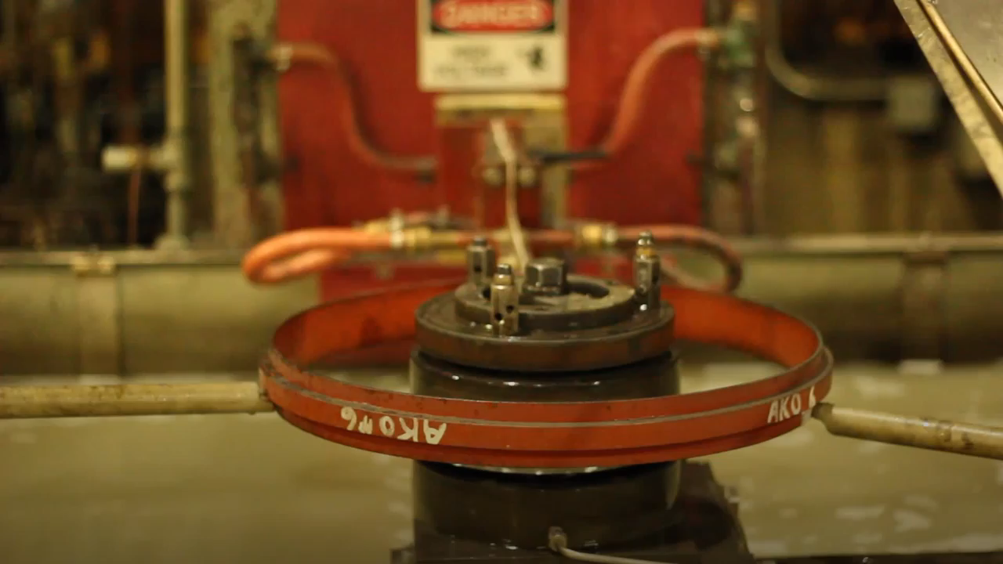
Case-Hardened Steels

Slide 30
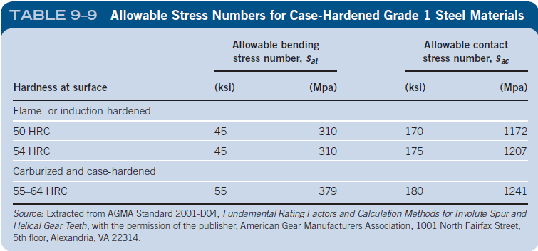
Case-Hardened Steels

Slide 31

Iron and Bronze Gear Materials
Two types of iron used for gears are gray cast iron and ductile (sometimes called nodular) iron.
Bronzes. Four families of bronzes are typically used for gears: (1) phosphor or tin bronze, (2) manganese bronze, (3) aluminum bronze, and (4) silicon bronze. Yellow brass is also used.

Slide 32
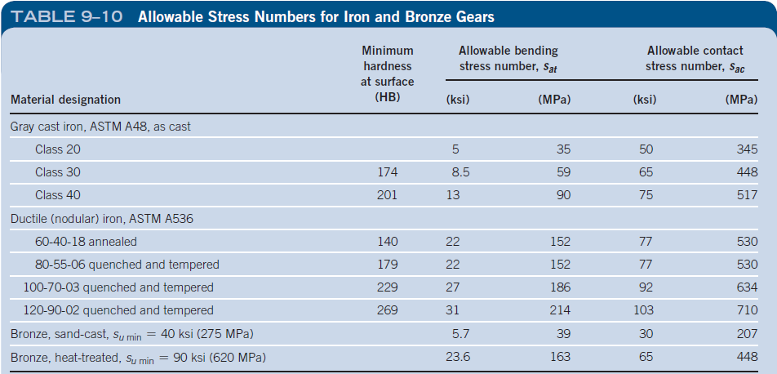
Iron and Bronze Gear Materials

Slide 33
Selection of Gear Materials
We develop here an approach for specifying steel for the gears.
The goal of the process is to ensure that the predicted stresses are less than the allowable strength of the material. Inputs to the decisions are:
Estimated bending stress number, s_{t},
Estimated contact stress number, s_{c}
Desired service life and reliability for the gears,
Chosen safety factor, SF,
Allowable bending stress number, s_{at}, and allowable contact stress number for the material, s_{ac}

Slide 34
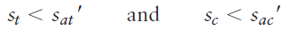
General principles for specifying materials
We use the following relationships to guide the process of specifying suitable materials for gears.
Conditions are:
Operating temperatures are above 32°F (0°C) and below 250°F (121°C).
The materials are exposed to 10⁷ loading cycles.
The expected reliability is 99%, less than one failure in 100.
The safety factor, SF, is 1.00.

Slide 35
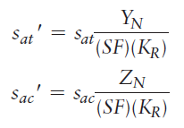
General principles for specifying materials
The adjustments to sat and sac considered here take the form:
where SF = safety factor
K_{R} = reliability factor
Y_{N} = bending strength stress cycle factor
Z_{N} = pitting resistance stress cycle factor

Slide 36
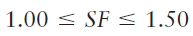
General principles for specifying materials
Safety factor: The value of SF is typically taken to be 1.0 because most of the uncertainties involved in computing the bending and contact stresses are included in the equations for s_{t} and s_{c} by the factors K_{o}, K_{s}, K_{v}, and K_{m}.
For special load applications, AGMA recommends:

Slide 37
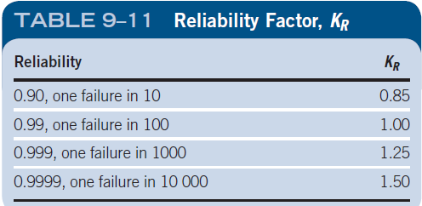
General principles for specifying materials
Reliability factor: Table 9–11 shows typical values for K_{R} and the choice of which to apply in a given project is a design decision.

Slide 38
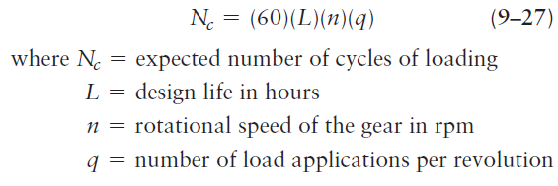
General principles for specifying materials
Desired life of the gear drive: Designers must evaluate each project to specify what the design life is to be.
The range from 20 000 to 30 000 hours for general industrial machines is a reasonable choice unless known conditions of the types listed exist.
number of load cycles can be computed using this equation:

Slide 39
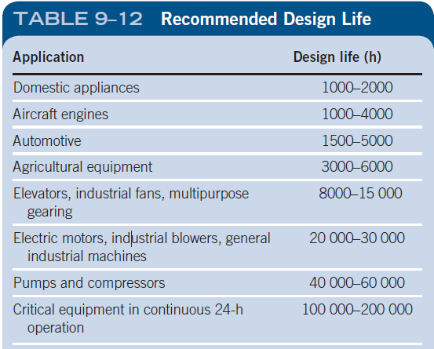
General principles for specifying materials
Desired life of the gear drive: Designers must evaluate each project to specify what the design life is to be.

Slide 40
Stress Cycle Factors
Figures 9–21 and 9–22 show recommended values of Y_{N} for bending stress and Z_{N} for contact stress for steel gears. Features of these graphs include:
Each is plotted on log–log scales with the number of load cycles on the horizontal axis and the stress cycle factor on the vertical axis.
The stress cycle factor is approximately 1.0 for 10⁷ load cycles on both graphs.
The stress cycle factors are less than 1.0 for load cycles higher than 10⁷ and the values are independent of the type of steel or its condition.
These charts do not apply to cast iron or to nonferrous materials such as bronze.

Slide 41
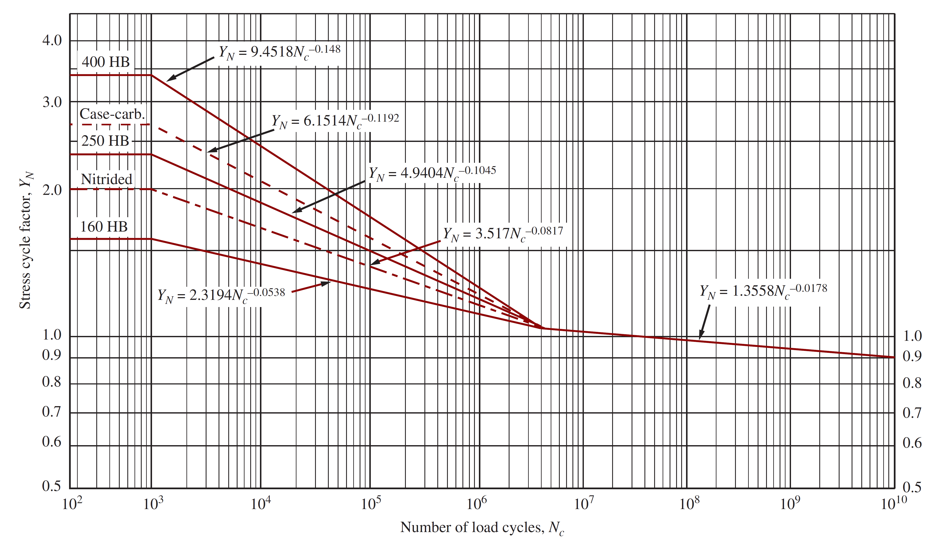
Bending strength stress cycle factor, YN
FIGURE 9–21: Bending strength stress cycle factor, YN

Slide 42
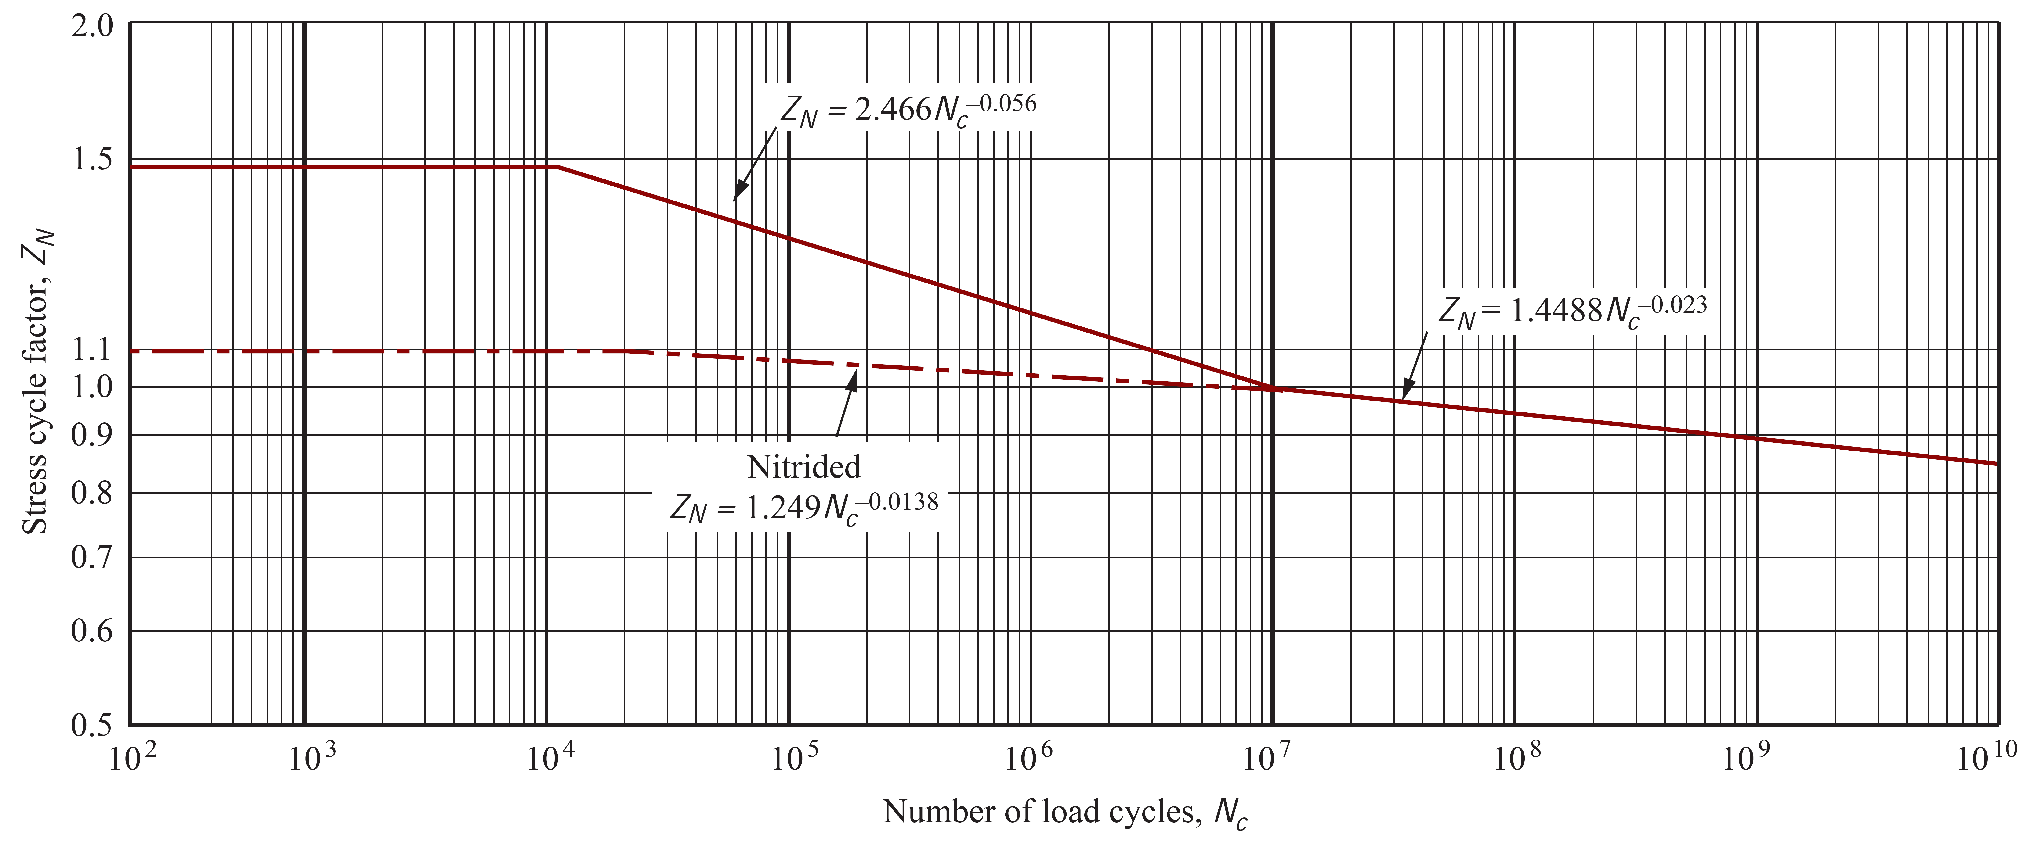
Pitting Resistance stress cycle factor, Z_{N}
FIGURE 9–22Pitting Resistance stress cycle factor, Z_{N}

Slide 43
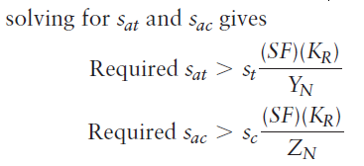
Materials for gear

Slide 44
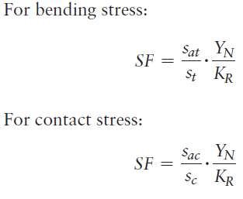
Safety Factor for Material Selection

Slide 45
Example Problem
Consider three different materials and calculate the safety factor for the pinion and gear using the results from Example Problem 9–3 for the computed bending stresses.
Design for a reliability of 0.999, fewer than one failure in 1000.
The application is a drive for an industrial saw that will be fully utilized on a normal, one-shift, five-day per-week operation. The materials proposed are:
Ductile iron ASTM A536 type 80-55-06 quenched and tempered.
Though hardened steel pinion and gear: SAE 4340 OQT 1000.
SAE 8620 steel pinion and gear case hardened by carburizing to a hardness of Rockwell C 60-64 with a minimum effective case depth of 0.025 in.

Slide 46
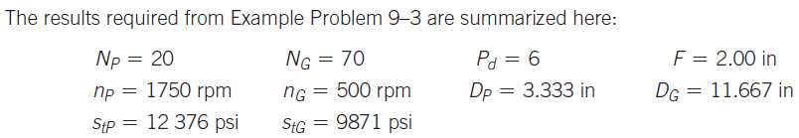

Slide 47
Design Approach for Gear Drives
First the geometric characteristics are specified, and then the required material properties, particularly the hardness of the gear teeth, are computed. Finally, a suitable material is specified that meets those requirements.
Some overall objectives of a design are listed below. The resulting drive should
Be compact and small
Operate smoothly and quietly
Have long life
Be low in cost
Be easy to manufacture
Be compatible with the other elements in the machine, such as bearings, shafts, the housing, the driver, and the driven machine.

Slide 48
PROCEDURE FOR DESIGNING A SAFE AND LONG-LASTING GEAR DRIVE
From the design requirements, identify the input speed of the pinion, n_{P}, the desired output speed of the gear, n_{G}, and the power to be transmitted, P.
Choose the type of material for the gears, such as steel, cast iron, or bronze.
Considering the type of driver and the driven machine, specify the overload factor, K_{o}, using Table 9–1. The primary concern is the expected level of shock or impact loading.
Specify a trial value for the diametral pitch. When steel gears are used, Figure 9–11 provides initial guidance.

Slide 49
PROCEDURE FOR DESIGNING A SAFE AND LONG-LASTING GEAR DRIVE
Specify the face width within the following recommended range for general machine drive gears.
Specify or compute the following values:
Number of teeth in the pinion (N_{P}) and the gear (N_{G}) to achieve the desired output speed of the gear.
Compute the actual output speed of the gear and ensure that it is satisfactory.
Compute key geometric features: pitch diameters D_{P}, D_{G}, and center distance, C. Judge that they are acceptable.
Compute the pitch line speed, v_{t}, and the transmitted load, W_{t}.
Determine the geometry factors for bending stress, J_{P} and J_{G}, and the geometry factor for contact stress, I.
Specify the quality number for the teeth of the gears using Table 9–5 as a guide.
Determine values for all of the factors in Equation (9–16) for bending stress and Equation (9–23) for contact stress.

Slide 50
PROCEDURE FOR DESIGNING A SAFE AND LONG-LASTING GEAR DRIVE
Compute the bending stress and the contact stress on the pinion and gear teeth. Judge whether the stresses are reasonable (neither too low nor too high) in terms of being able to specify a suitable material. If not, select a new pitch or revise the number of teeth, pitch diameter, or face width. Typically the contact stress on the pinion is the limiting value for gears designed for a long life.
Iterate the design process to seek more optimum designs. It is not unusual to make several trials before settling on a particular design. Using computer aids, such as the spreadsheets described in Sections 9–11 and 9–12, can make successive trials quickly.

Slide 51
Guidelines for Specifying Metallic Materials for Gears
Given the bending stress, st, the contact stress, sc, and the rotational speed of both the pinion, nP, and the gear, nG from analyses
Decide on the safety factor; typically SF = 1.00 unless unusual conditions exist. AGMA recommends values for SF from 1.0 to 1.5.
Decide on the desired reliability and use Table 9–11 to determine KR; typically use KR = 1.00 for a reliability of 0.99 (one failure in 100).
Specify the desired life in hours for the gears using Table 9–12 as a guide.
Compute the expected number of load cycles for the pinion and the gear using Equation (9–27).
Use Figure 9–21 to determine Y_{N} for the pinion and Figure 9–22 to determine Z_{N} for the gear. The values may be read from the graphs or computed from the equations given in the figures.

Slide 52
Guidelines for Specifying Metallic Materials for Gears
Use Equation (9–31) to evaluate the required s_{acP} for the pinion because it typically has the most critical value for s_{ac}. Then consult Figure 9–19 to determine if through-hardened Grade 1 steel can be used.
Then consult Figure 9–19 to determine if through-hardened Grade 1 steel can be used. Enter the chart from the value of sac on the vertical axis; project horizontally to the Grade 1 line; then project vertically down to the Brinell hardness axis to read the minimum acceptable HB hardness.
Note that the value should be between HB 180 and HB 400. The most desirable portion of this range is about HB 250 to HB 400.
If the value is lower, then a more compact gear size can usually be designed.
No value greater than HB 400 should be considered for through-hardened steels. Only Grade 1 steels are recommended.
Step 7 produces a reasonable result, proceed to compute s_{acG} for the gear using Equation (9–31) and compute sat for both the pinion and the gear using Equation (9–30).

Slide 53
Guidelines for Specifying Metallic Materials for Gears
Using the required hardness HB for the pinion computed in Step 7, specify a suitable material and its heat treatment using Appendices 3 and 4.
If Step 8 is not successful, either redesign the gears or consider using case-hardened steel with the values for s_{ac} taken from Table 9–9.
If the design is using cast iron or bronze, consult Table 9–10 for values for s_{ac}.

Slide 54
Example Problem
Design a pair of spur gears to be used as a part of the drive for a chipper to prepare pulpwood for use in a paper mill. Intermittent use is expected. An electric motor transmits 3.0 horsepower to the pinion at 1750 rpm and the gear must rotate between 460 and 465 rpm. A compact design is desired.

